Slide 1

Discussion: CASE DISCUSSION
CANADIAN PACIFIC RAILWAY: CRISIS COMMUNICATION
EDB 9120: Evidence Management – Dr. Richard Baskerville
Kayongo, Mahgoub, Manikandan, Rajakumar
March 23, 2020

Slide 2

Agenda
Background
Research Question & PICOC
Research of the issue using Evidence based method/CAT
Evidence: Findings
Recommendations
Conclusion
Limitations & Implications for Future Research
References

Slide 3
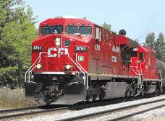
About Canadian pacific railways
Canadian Pacific Railways was founded in 1881 to connect Canada
Now it became state of art railroad service provider of transportation solutions
Utilizing Big Data from a line of business, it built programs that better anticipate issues and take preventive measures before an accident occurs. Example: Train Vision Systems, Automated Bridge and Track Monitoring

Slide 4
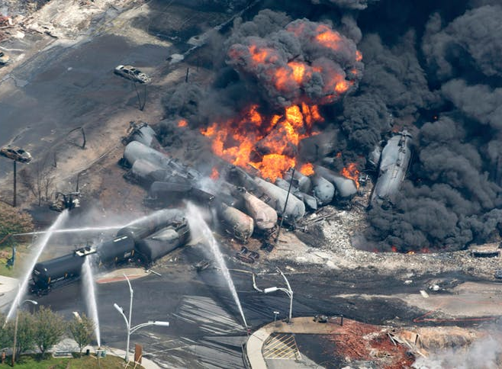
Crisis: Lac-Megantic Disaster
On July 6th 2013, a runaway train carrying flammable fuel blew up in small town of Lac-Magnetic in the Quebec province in Canada
Driver less train left unattended on the track rolled down the hill, derailed and exploded causing 47 deaths
Over 2 mill gallons of crude oil were spilled and more than 500,000 metric tons of soil over 30 hectares were contaminated causing evacuation of the town

Slide 5
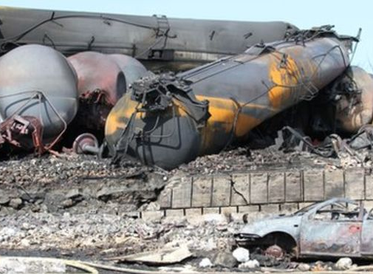
Communication during crisis
Crisis response communication includes conveying ongoing crisis events to stakeholders, decision making within the crisis management team, and organizational decisions regarding whether and what amount of information to share (Hale, J. E., 2005)
Just because you communicate during a crisis doesn't mean you necessarily make the situation better (Coombs, W. T., 2015)
In a crisis and emergency context, communication efforts must sometimes deviate from the planned strategies and come back to simple, direct, and “human” communication methods in order to adapt to the realities of the victims (David, M. D. and M.-E. Carignan, 2017).
EDB 9120 – Evidence Based Management Spring 2020, Kayongo, mahgoub, Manikandan, & Rajakumar

Slide 6

Background Videos
https://youtu.be/larpYRCvZoU
https://www.youtube.com/watch?v=5argWW4NjYU
https://youtu.be/5argWW4NjYU

Slide 7
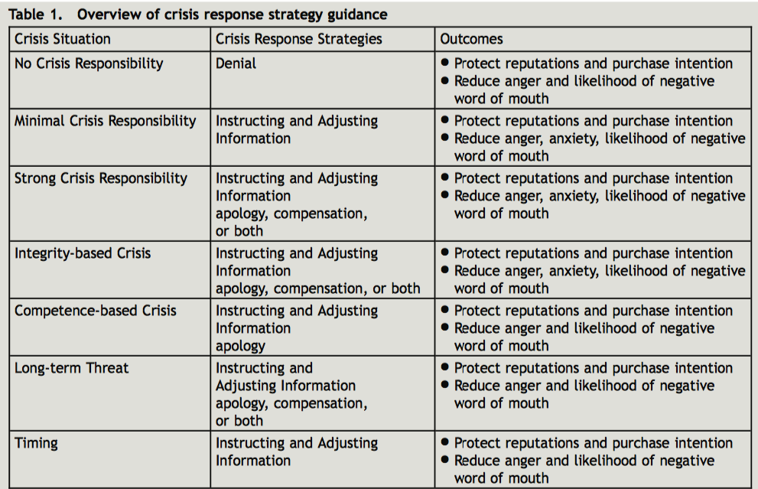
Crisis response strategy overview
Source: Coombs, W.T. (2015). The value of communication during a crisis: Insights from strategic communication research. Business Horizons, 58(2), 141 -148

Slide 8
RESEARCH QUESTION & PICOC
“How do various situational factors affect the effectiveness of basic crisis response strategies?”
P = Problem or Population Crisis Communication
I = Intervention or success factor Evidence based crisis response strategies
C = Comparison Case study - Canadian railway - oil spill
O = Outcome A Manager’s guideline to crisis response strategies
C = Context Strategies for effective crisis communication for all stakeholders

Slide 9

what does science say? CAT suggested SEARCH “WORDS” FROM THE CASE
CRISIS COMMUNICATION
CRISIS RESPONSE
SITUATIONAL CRISIS COMMUNICATION

Slide 10
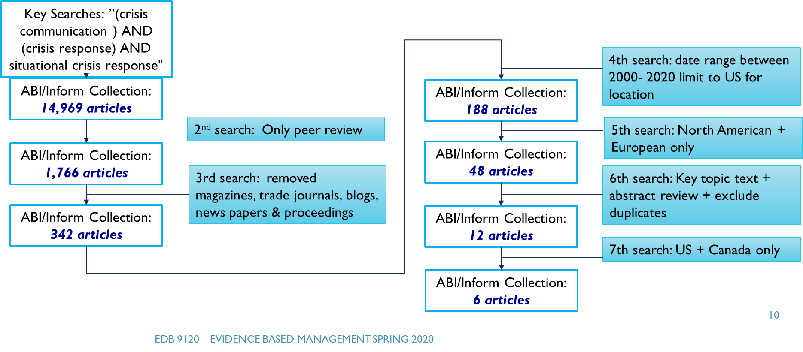

Search strategy

Slide 11
RESULTS: OVERALL VALIDITY
# | Article Titles | Research Approach | Empirical Basis | Analysis Method | Overall Validity
1 | Pet Food Panic: Procter and Gamble’s Use of Crisis Response Advertising (CRA) in Recall Crisis | Case studies | Application of Benoit’s Theory of Image Repair Discourse to the P&G’s advertising campaign during the 2007 Menu Foods pet food recall crisis | This case study utilizes elements of both qualitative content analysis and quantitative ﬁnancial analysis. | Conclusion was drawn from impact of CRA on P&G’s ﬁnancial performance but failed to infer whether the outcomes were due to effective CRA strategies or to favorable or unfavorable market trends during the crisis period (Siomkos, 1992).
2 | Crisis communication adaptation strategies in the MM&A train explosion in Lac-Mégantic downtown. Going back to field communication. | Case studies | Use of the “deliberate strategy” that has been planned ahead of time, and an “emergent strategy” that grows out of learning and interactions (patterns) (Mintzberg, 2007, p. 4) | in-depth interviews, analysis of artifacts, and news analysis | The importance adapting the initial crisis communication plan based on realities in the field that could be reiterated with simplified communication methods.
3 | Debunking the myth of denial’s effectiveness in crisis communication: context matters | Multiple Experimental Design studies | Survey after an experiment among 119 University students | Quantitative analysis | Conclusion drawn about the dangers of using denial during crisis communication
4 | Giving Voice to the Silenced: Using Critical Discourse Analysis to Inform Crisis Communication Theory | Qualitative Multi-case study | Teun Van Dijk and Norman Fairclough analytical framework | Analysis of interviews and transcripts using the CDA method | Evidence to add CDA to crisis communication theory
5 | Shareholder Value and Crisis Communication Patterns: An Analysis of the Ford and Firestone Tire Recall | Multi Disciplinary approach Case Study | Examination and analysis of media strategies impact on stock market for Ford and Firestone during product recall crisis. Use of IRT (1995) and ADD (1991) theories | (1) Interviews, (2) Review of literature (228 articles), and (3) Evaluation of quotes during 6 years’ crisis media coverage. | Conclusion drawn from approaches taken by two firms in response to the crisis
6 | A Cold Cut Crisis: Listeriosis, Maple Leaf Foods, and the Politics of Apology | Case study | (1) Exploration of Maple Leaf’s crisis communication strategy response (2) Distinction between cognitive and normative expectations (3) Theoretical framework to understand crisis response (Holmström, 2003; Knight & Roper, 2009). | Literature Review of crisis management | Conclusion drawn from theoretical background and literature review

Slide 12
RESULTS: Key findings
# | Article | Finding 1 | Finding 2 | Finding 3 | Translation
1 | Pet Food Panic: Procter and Gamble’s Use of Crisis Response Advertising (CRA) in Recall Crisis | By combining CRA strategies of bolstering and corrective action and ‘forgiveness’, an organization may successfully restore its image, even though its success may not be initially apparent. (Brinson and Benoit, 1996). | A mix of traditional media, the internet and social media play an increasingly critical role to communicate with the public during crisis situations, Perry et al. (2003): Taylor & Perry (2005). | The CEO can be a powerful representative of the company, but only if they ‘convey both passion and vision on the one hand, and integrity and competence on the other’ (Stock, 2003). | Combining different CRA strategies can fulﬁll the vital function of providing information from the company’s perspective during crisis (Cowden and Sellnow, 2002) while also managing the public’s image of the corporation.
2 | Crisis communication adaptation strategies in the MM&A train explosion in Lac-Mégantic downtown. Going back to field communication. | Finding alternative communication strategies other than social media to effectively communicate with evacuated disaster victims in a temporary dead zone where the fiber-optic cables networks blew up during the blast. | Communicating complexity of adapting exceptional contingency public health messages in a context with a digital divide and low literacy among disaster victims. | In a crisis and emergency context, communication efforts must sometimes deviate from the planned strategies to simple, direct, and “human” methods in order to adapt to the realities of the victims. | Case focused on crisis communication strategies to disaster victims. There is need to study different stakeholder reactions in various social media channels (Coombs and Holladay, 2014).
3 | Debunking the myth of denial’s effectiveness in crisis communication: context matters | Increase in reputational damage and stakeholder anger | Decrease in reputation scores | Favorable organization reputation with the user of positive action strategy | Denial and No response strategies were less successful when compared to positive action strategy
4 | Giving Voice to the Silenced: Using Critical Discourse Analysis to Inform Crisis Communication Theory | Focus on global and local meanings during crisis communication | Identification of a social problem with a semiotic aspect | Effective use of ingratiation, concern and compassion | New framework for crisis communication to include CDA techniques such as silenced discourses.
5 | Shareholder Value and Crisis Communication Patterns: An Analysis of the Ford and Firestone Tire Recall | While using different strategies in approaching crisis, both firms suffered significant losses in market capitalization. | Strategies used to address effectiveness of crisis response strategies. | Managers can maintain shareholder value during corporate crises if they use the right communication strategies | (1) Importance of practicing strategic and effective communication during corporate crisis. (2) Evidence of correlation between corporate communication strategies and stock returns. (3) Growing literature in crisis communication and theories of crisis communication and management.
6 | A Cold Cut Crisis: Listeriosis, Maple Leaf Foods, and the Politics of Apology | Maple Leaf opted for a strategy of high visibility using the function of apologetic discourse. | Use of apologia as a strategy for reputational defense | Crises is a very critical moments in the life of an organization. The food industry today is deeply implicated in the global economy. | Crisis management involves a process whereby the organization utilizes different communicative techniques to realign its identity and reputation with the normative expectation of consumers and other stakeholders and re-establishment trust. Maple Leaf’s apology was effective in terms of restoring consumer trust and confidence
 | Translation

Slide 13

Recommendations
Providing the right level of information during crisis while also managing the public’s image
Devising crisis communication strategies and practicing will improve delivery of effective communication during corporate crisis
Communicative techniques help improvise effect crisis management to realign identity and reputation with the stakeholders and strengthens trust

Slide 14

CONCLUSION
Consequences of “denial” during crisis communication. Careful vetting of “denial” strategy is needed before the company chooses to pursue that path
Evaluation of government policies during crisis communication
Inclusion of all affected policies during crisis communication
Crisis communication framework based on the facts in the field

Slide 15

Limitations
Use of case studies as a methodology to research Crisis Communication has limitations and findings may not be generalizable
Most case studies were consumer focused. More focus on marketing and product development strategies is needed to build customer relationships
In conducting interviews, there were difficulties in finding participants willing to speak which means results may be questioned
Focus on English Language News only during crisis communication to analyze global media is a potential limitation
Denial and No-response strategies were less successful when compared to positive action strategy

Slide 16

IMPICATIONS for future research
Growing need to study crisis communication and management to develop new theoretical approaches
More research is needed in the “apology technique” as an effective tool to restore consumer trust and confidence
There is a need to study stakeholder reactions in social media channels during corporate crisis
Further research is needed for loyalty in medical field using technology evidence-based decision making

Slide 17
References
Coombs, W.T., (2015). The value of communication during a crisis: Insights from strategic communication research. Business Horizons, 58, p.141–148.
Hale, J.E., Dulek, R. E., Hale, D. P., (2005). Crisis Response Communication Challenges: Building Theory From Qualitative Data. Journal of Business Communication, 42 (2), p.112–134.
David, M. D., & Carignan, M., (2017). Crisis communication adaptation strategies in the MM&A train explosion in Lac-Mégantic downtown. Going back to field. Corporate Communications: An International Journal, 22(3), p.369–38.
Lancendorfer, K.M., (2014). Pet Food Panic: Procter and Gamble’s Use of Crisis Response Advertising (CRA) in Recall Crisis. Corporate Reputation Review,17 (2), p. 94–113.

Slide 18
References
Coombs, W. T., Holladay, S. J., & Claeys, A. (2016). Debunking the myth of denial’s effectiveness in crisis communication: context matters. Journal of Communication Management, 20 (4), p.381–395
Carolyn Dunn, C., & Eble, M. (2014). Giving Voice to the Silenced: Using Critical Discourse Analysis to Inform Crisis Communication Theory. Springer Science and Business Media, Dordrecht.
Erickson, L.S., Erickson, S. L., Stone, M., Thomas, A., Hanson, T. A., Tolifson, A., Ngongoni, N., & Kalthoff, J. (2017). Shareholder Value and Crisis Communication Patterns: An Analysis of the Ford and Firestone Tire Recall. Academy of Strategic Management Journal, 16 (1), 20.
Greenberg, J., & Elliott, C. (2009). A Cold Cut Crisis: Listeriosis, Maple Leaf Foods, and the Politics of Apology. Canadian Journal of Communication, 34, 189–204.

